Slide 1
NLP (Natural Language Processing)
Group3
Paul
Sven
Mehak
Notes:
Paul

Slide 2

1.Problem Statement
Fake News Detection Using NLP
Build a machine learning model that can accurately predict fake news using natural language processing (NLP) techniques.
Approach:
Data Cleaning and Preprocessing.
TF-IDF-based feature extraction
Train, test, and evaluate different machine learning models.
Group 3 👽
Notes:
Paul

Slide 3
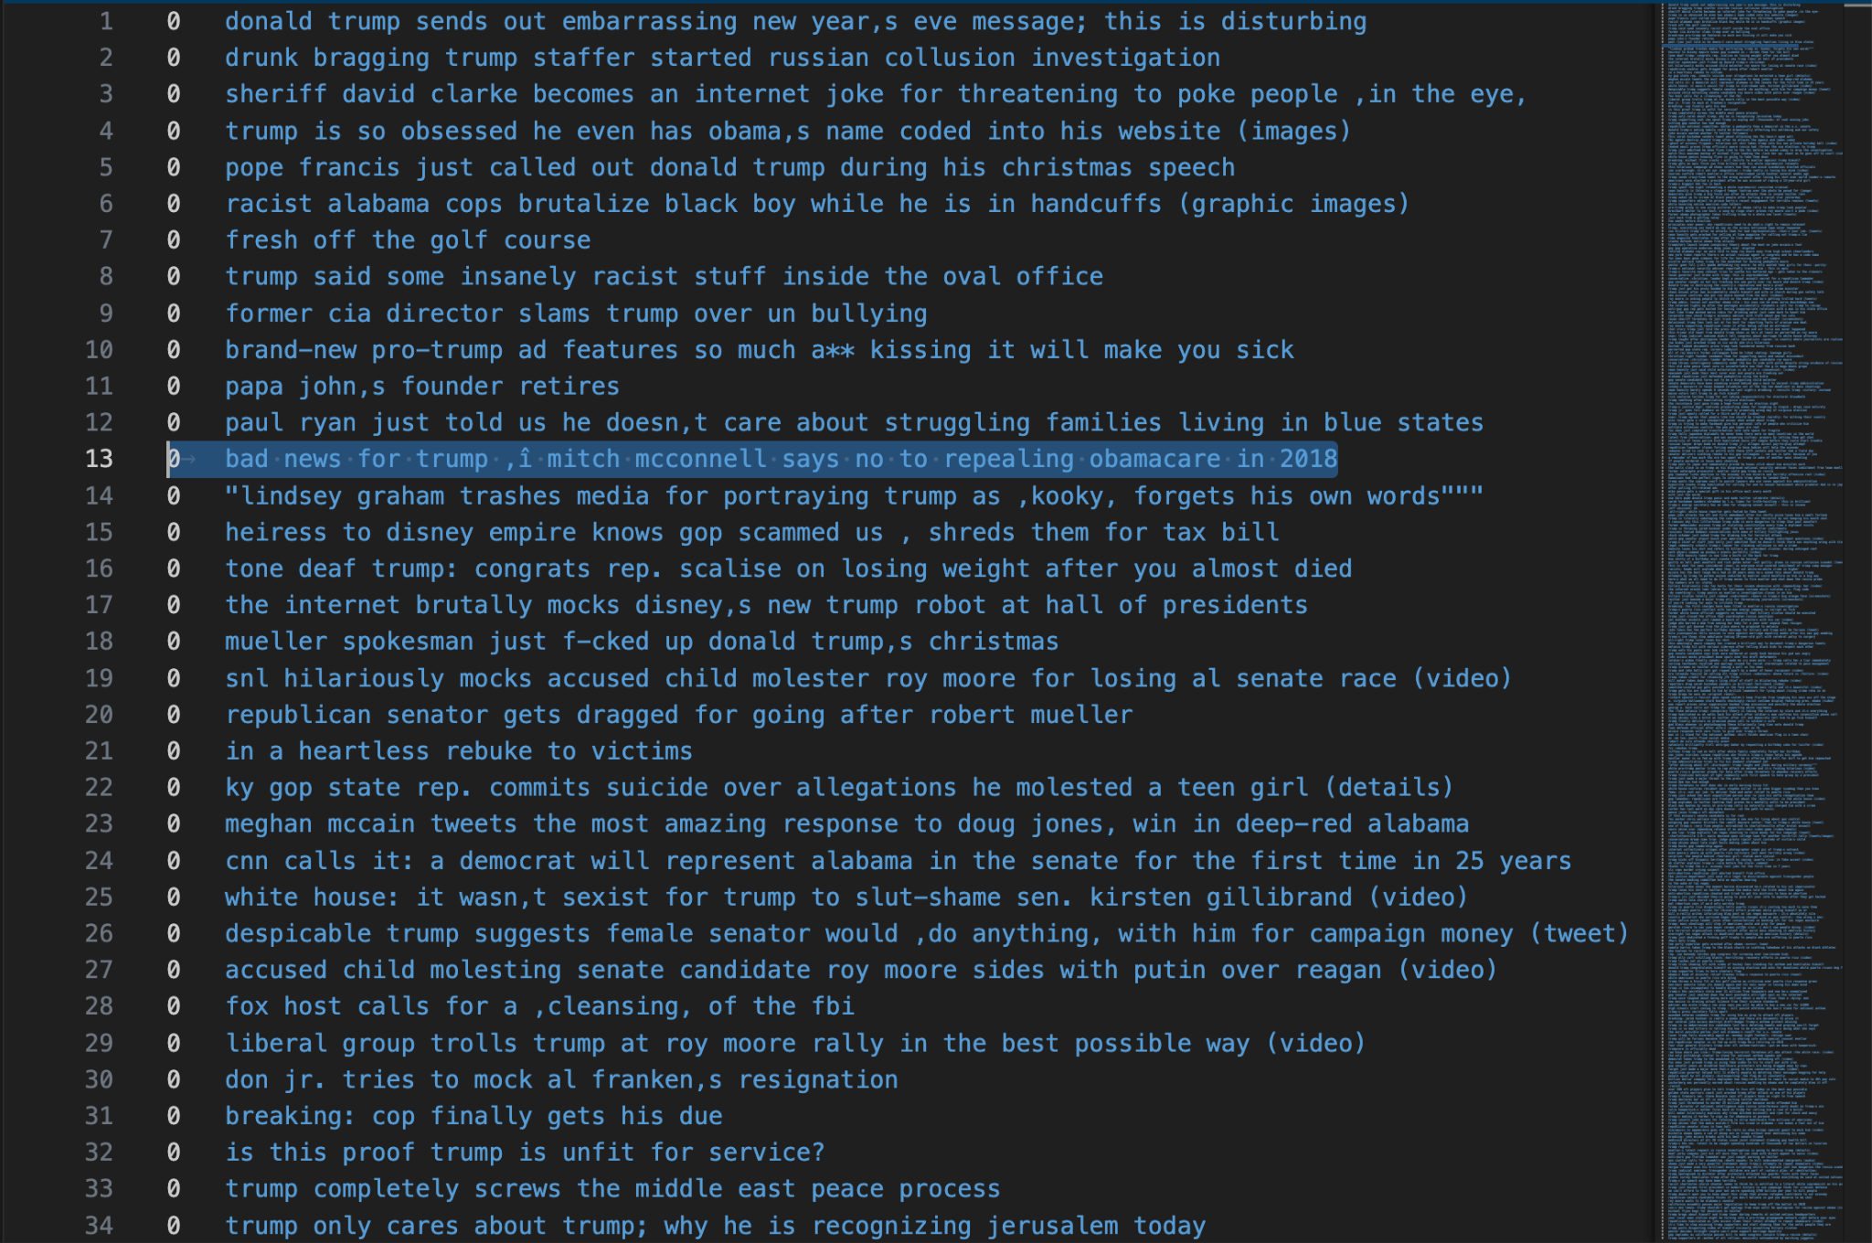
2. Fake News Dataset
Structure:
CSV file
34152 rows & 2 columns as input
stuffed with 50% fake (top) and 50% true headlines (bottom)
Columns:
label: 1 – true and 0 – fake
Features: headlines as text
Group 3 👽
Notes:
Paul

Slide 4
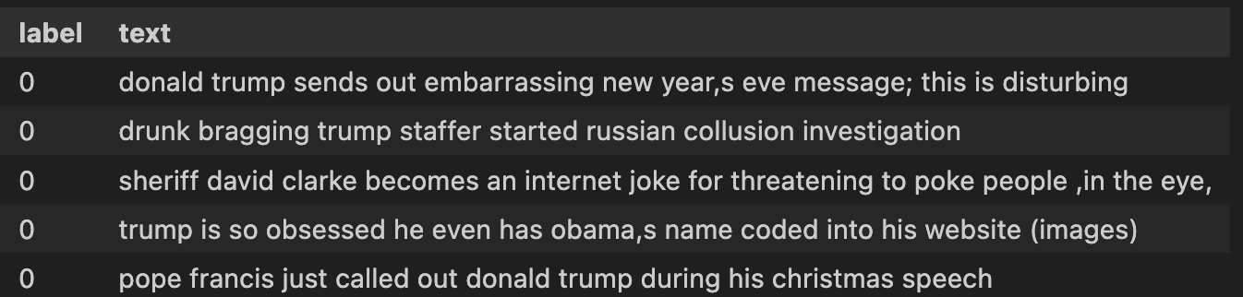
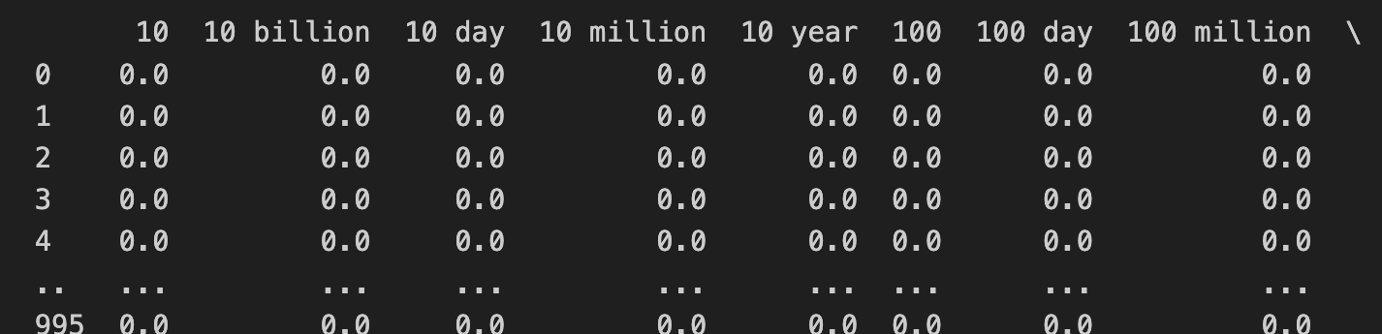
3. Data Preprocessing
Preparation:
Loading data and inspecting
Changing labels (label, text)
Preprocessing:
Removing special characters
Tokenizing and removing stopwords
Lemmatization with pos tagging
To handle semantic differences and word variants with a smaller dataset, we chose the more complex technique
Group 3 👽
Notes:
Paul POS stands for Part of Speech. It refers to the grammatical categories or classes that words in a sentence belong to, such as:
N: Noun (e.g., "dog", "car")
V: Verb (e.g., "run", "is")
J: Adjective (e.g., "beautiful", "quick")
R: Adverb (e.g., "quickly", "happily")
In this code, POS tagging is used to assign these categories to words so that the WordNet lemmatizer can accurately process and reduce words to their base forms (lemmas). For instance, knowing that "running" is a verb (V) allows the lemmatizer to convert it to "run."

Slide 5

4. TF-IDF: vectorizing text data
Transforms Text to Numeric Data:
Converts textual information into meaningful numerical features for machine learning models.
Why TF-IDF and not Bag of Words?
outperforms Bag of Words in capturing meaningful patterns
Weights words based on their uniqueness within documents and across the dataset
Helps models focus on informative terms rather than common words.
Group 3 👽
Notes:
Sven

Slide 6





5. Models trained
Logistic Regression
Simple baseline model commonly used for binary classification tasks
Decision Tree
Non-linear algorithm capturing complex decision boundaries
Naive Bayes Classifier
leveraging feature independence, making it fast and effective for text classification
Random Forest
Technique combining multiple decision trees for improved accuracy
XGBoost
Gradient boosting model optimized for speed and performance
Group 3 👽
Notes:
Sven

Slide 7
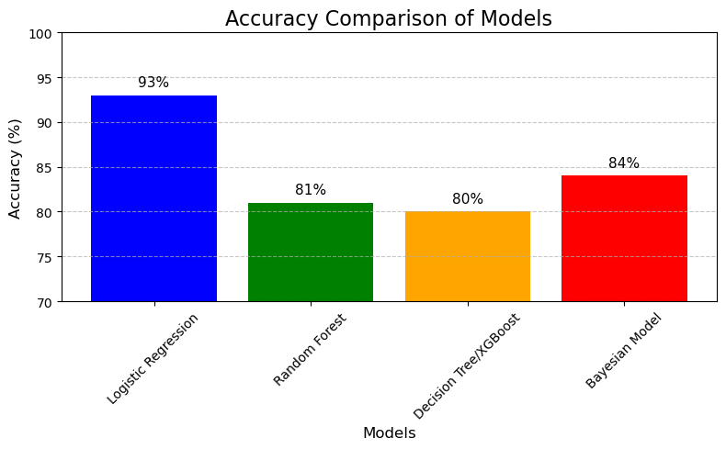
6. Model Comparison and Performance Analysis
Accuracy Results:
Logistic Regression: 93% Accuracy (Best Performer)
Random Forest: 81% Accuracy
Decision Tree/XGBoost: 80% Accuracy
Bayesian Model: 84% Accuracy
Stacking Models:
Experimented with combining different models using Stacking.
Results showed no significant improvement over Logistic Regression (accuracy remained at 93%).
Group 3 👽
Notes:
Sven

Slide 8
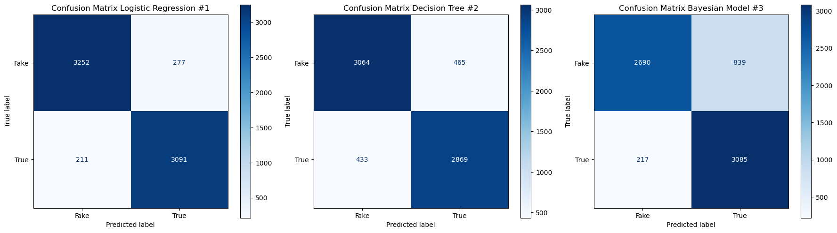

7. Special findings in
Confusion matrices of models:
Group 3 👽
Notes:
Sven

Slide 9
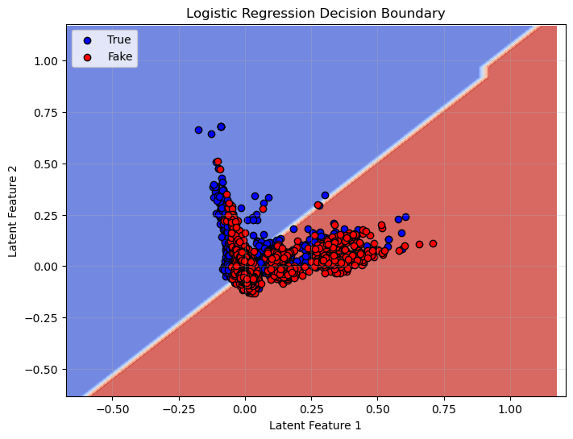
8. Why Logistic Regression?
Superior Performance:
Achieved 93% accuracy, outperforming other models consistently.
Efficiency:
Computationally efficient, making it ideal for larger datasets.
Handles TF-IDF features well due to its linear nature.
Interpretability:
Coefficients provide insights into the importance of features
(words or n-grams).
Generalizability:
Demonstrated robust performance across training and testing datasets.
Reduced risk of overfitting compared to complex models like Random Forest and XGBoost.
Group 3 👽
Notes:
Mehak

Slide 10
9. Summary
Problem: Build a fake news detection model using NLP.
Process:
Preprocessed text data using tokenization, stopword removal, and lemmatization.
Transformed text using TF-IDF vectorization.
Trained and tested models with Logistic Regression.
Outcome:
Logistic Regression achieved high accuracy and recall.
Predicted labels successfully for unseen data.
Group 3 👽
Notes:
Mehak

Slide 11
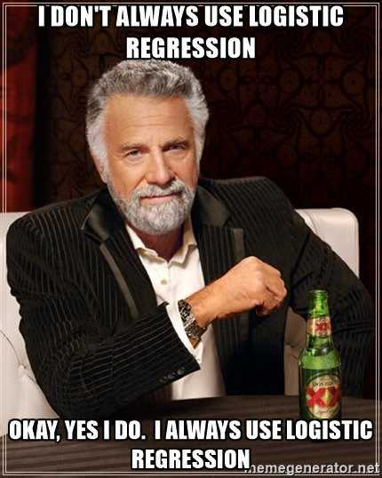
10. Key Learning
Emphasized refining preprocessing, feature extraction, and model selection to optimize results.
Light-weight model can be best approach.
Improved teamwork skills in handling various project components, including coding and evaluation, setting with pushing & pulling in Github.
Understood the value of visualizations (e.g., confusion matrices) for clear communication of results.
Group 3 👽
Notes:
Mehak

Slide 12
Thank you.
Any Question?
Notes:
Mehak

